Slide 1
Bioinformatic Identification of Transcriptional Regulatory Motifs Responsible for Pollen-Specific Expression of Hydroxyproline-Rich Glycoproteins in Arabidopsis Thaliana Yichao Li

Slide 2
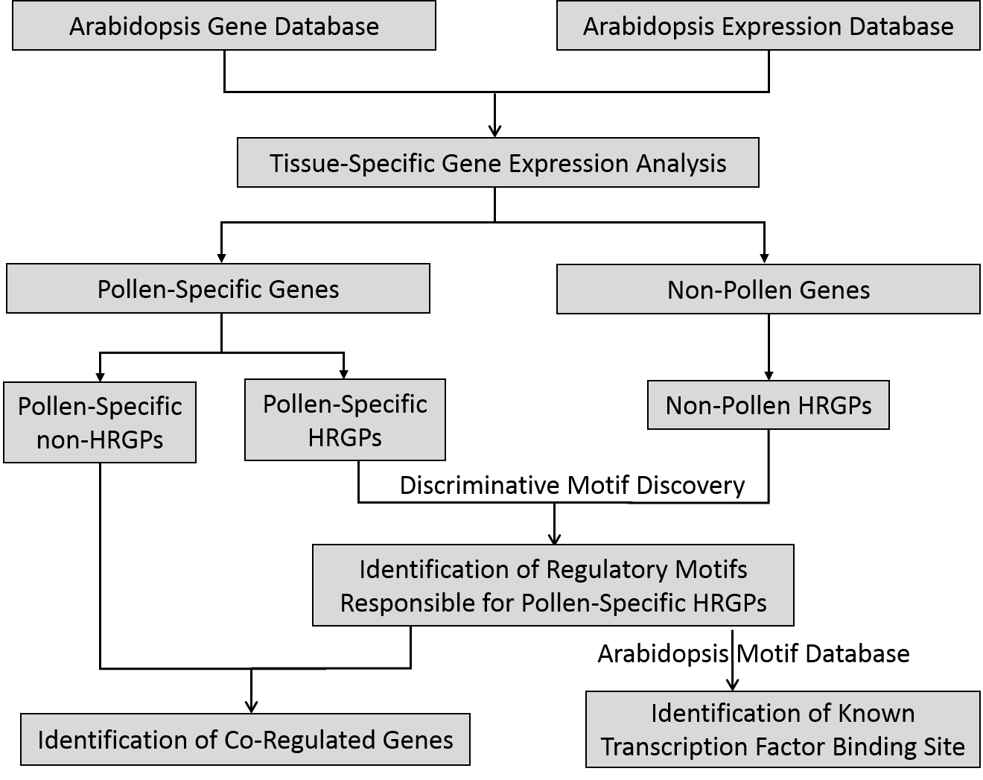
Figure 1. Bioinformatics workflow. Arabidopsis gene database is using 33602 TAIR10 genes. Arabidopsis expression database is using Araport11 public RNA-seq dataset. A tissue-specific gene expression analysis is performed using the above two as inputs. The analysis involves calculating the tissue-specific index, Tau, for each gene. Gene with Tau > 0.85 is defined as tissue-specific expressed. The analysis has characterized 983 pollen-specific genes (including 13 HRGPs and 970 non-HRGPs) and 132 non-pollen HRGPs. Discriminative motif discovery is used to identify regulatory motifs responsible for pollen-specific HRGPs, which is then used to search co-regulated genes in other pollen-specific genes. The discovered motifs are also compared to Arabidopsis motif database to check known motif overlaps.

Slide 3
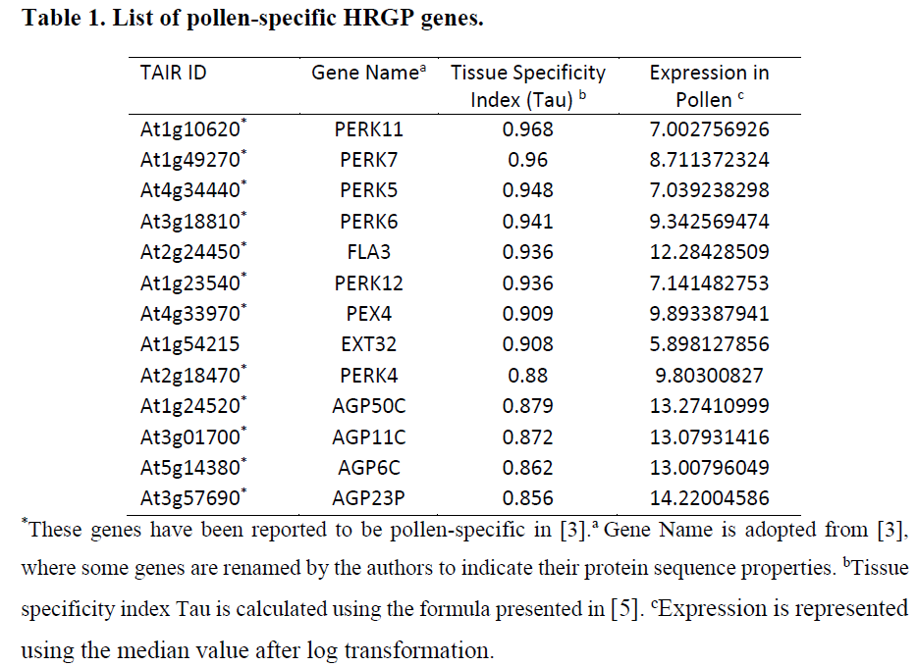

Slide 4
Figure 2. Expression profile of pollen-specific HRGPs. Expression is represented using the median expression value in each tissue. Pollen is the largest expressed tissue (blue line). Flower is the second largest expressed tissue (grey line).

Slide 5
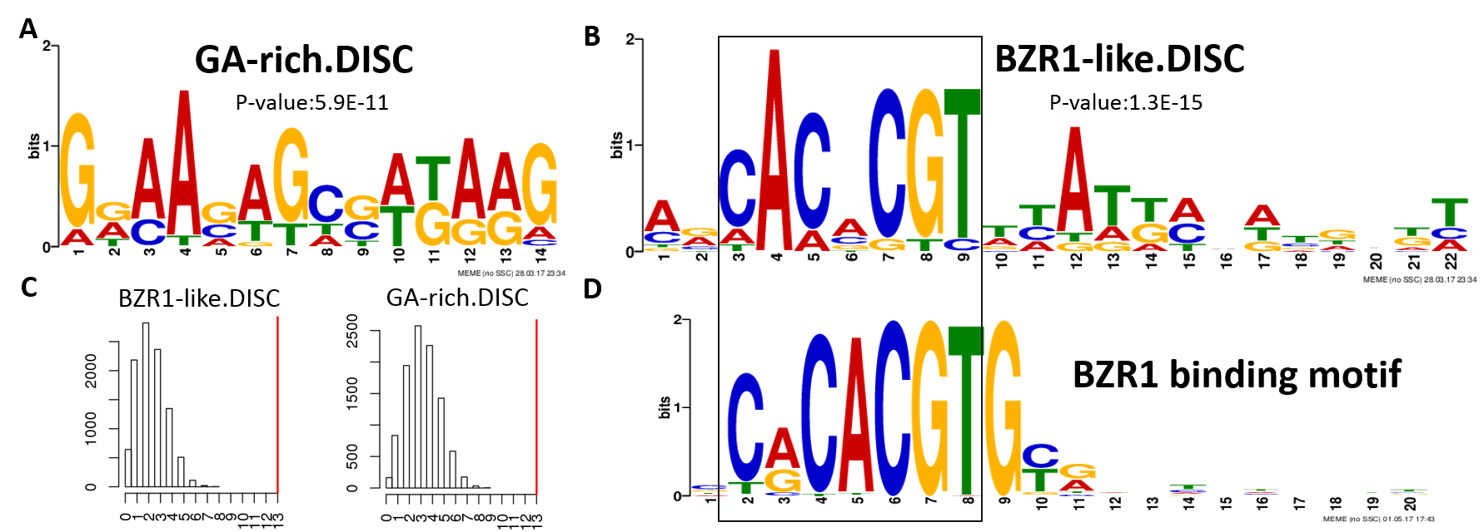
Figure 3. Novel motifs for pollen-specific HRGPs. (A) GA-rich motif was discovered with a significant p-value at 5.9E-11. (B) BZR1-like motif was discovered with a significant p-value at 1.3E-15. (C) Enrichment of the discovered motifs in the promoter regions of pollen-specific HRGPs. Number of observed occurrences (red line) was compared to the expected distribution calculated from randomly selected non-pollen HRGP promoters (histogram). (D) BZR1 binding motif derived from DAP-seq[7].

Slide 6
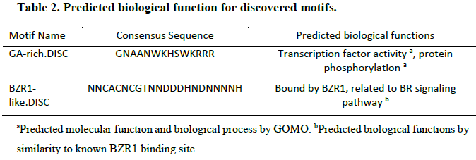

Slide 7
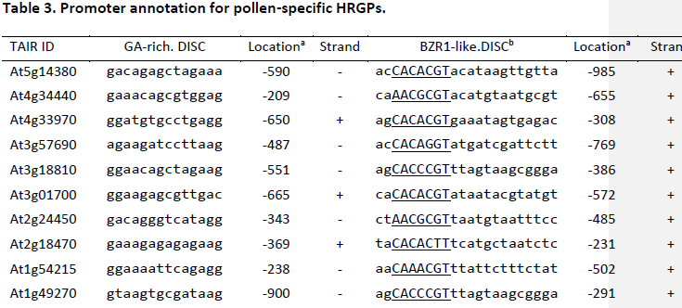
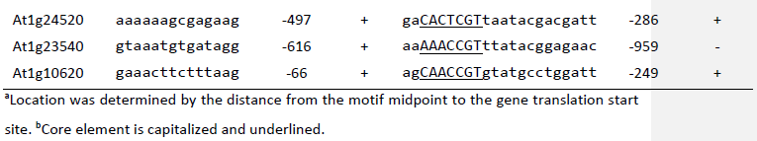

Slide 8
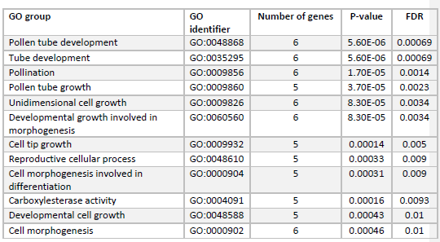
Table 4. Statistical significant function groups in the co-regulated pollen-specific non-HRGPs.

Slide 9
